Slide 1
PROJECT PRESENTATION -1 ON INTRODUCTION TO PYTHON LIBRARY NUMPY BY DHIRAJ SHENDE

Slide 2
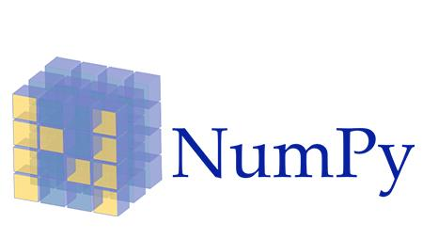

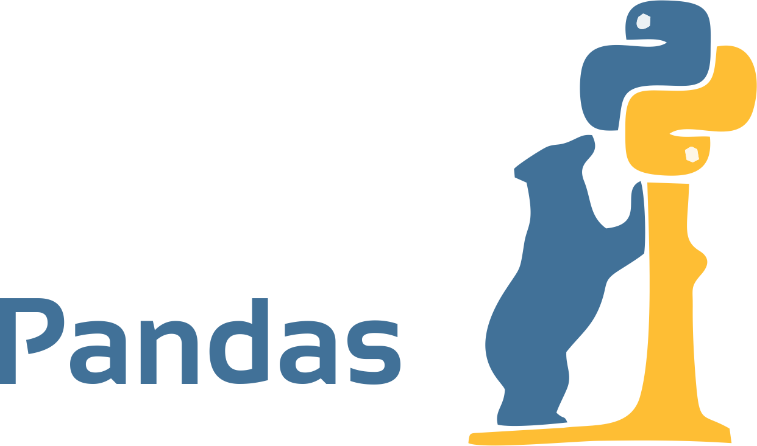
---
LIBRARIES IN PYTHON
Python library is a collection of functions & methods that allows you to perform many actions without writing your code

Slide 3
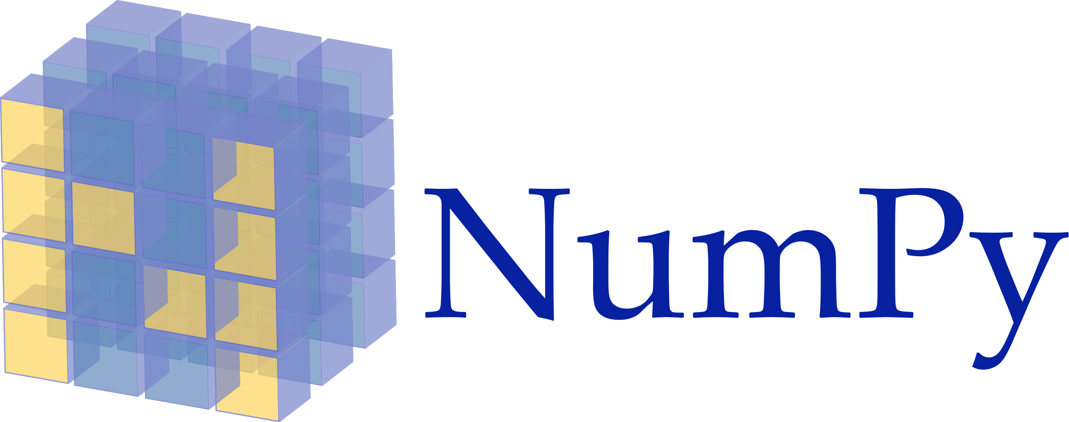

Python NumPy
NumPy stands for Numerical python and is the core library for numeric and scientific computing
55 It consists of multi-dimensional array objects and a collection of routines for processing those arrays

Slide 4
Creating NumPy Array
Single-dimensional Array
Multi-dimensional Array
In [3] : import numpy as np
n1=np.array([10,20,30,40])
n1
Out [3] : array(10,20,30,40)
In [6] : import numpy as np
n2=np.array([10,20,30,40],[40,30,20,10])
n2
Out [6] : array( [ [10,20,30,40],
[40,30,20,10] ])

Slide 5
Initializing NumPy Array
Initializing NumPy array within a range
Initializing NumPy array within a range
In [34] : import numpy array as np
n1 =np.array(10,20)
n1
Out [34] : array([10,11,12,13,14,15,16,17,18,19])
In [35] : import numpy array as np
n1 =np.array(10,50,5)
n1
Out [35] : array([10,15,20,25,30,35,40,45])

Slide 6
Initializing NumPy Array
Initializing NumPy array with random numbers
In [46] : import numpy array as np
n1 =np.random.radint(1,100,5)
n1
Out [46] : array([95,88,26,22,76])

Slide 7
NumPy Shape
Checking the shape of NumPy arrays
In [4] : import numpy array as np
n1 =np.array([1,2,3],[4,5,6]])
n1.shape
Out [4] : (2,3)
9

Slide 8
Joining NumPy Arrays
vstack()
hstack()
In [32] : import numpy as np
n1= np.array([10,20,30])
n2= np.array([40,50,60])
np.vstack((n1,n2))
Out [32] : array ( [ [ 10,20,30],
[ 40,50,60] ] )
In [32] : import numpy as np
n1= np.array([10,20,30])
n2= np.array([40,50,60])
np.hstack((n1,n2))
Out [32] : array ( [ 10,20,30,40,50,60] )
Column_stack()
In [32] : import numpy as np
n1= np.array([10,20,30])
n2= np.array([40,50,60])
np.column_stack((n1,n2))
Out [32] : array ( [ [ 10,40],
[20,50],
[30,60]])

Slide 9
NumPy Intersection & Difference
In [10] : import numpy as np
n1=np.array([10,20,30,40,50,60])
n2=np.array([50,60,70,80,90])
In [11] : np.intersect1d(n1,n2)
Out [11] : array([50,60])
In [10] : import numpy as np
n1=np.array([10,20,30,40,50,60])
n2=np.array([50,60,70,80,90])
In [23] : np.setdiff1d(n1,n2)
Out [23] : array([10,20,30,40])
In [10] : import numpy as np
n1=np.array([10,20,30,40,50,60])
n2=np.array([50,60,70,80,90])
In [20]: np.setdiff1d(n2,n1)
Out [20] : array([70,80,90])

Slide 10
NumPy Array Mathematics
Addition of NumPy Arrays
In [13] : import numpy as np
n1= np.array([10,20])
n2= np.array([30,40])
np.sum([n1,n2])
Out [13] : 100
In [14] : np.sum([n1,n2],axix=0)
Out [14] : array([40,60])
In [15] : np.sum([n1,n2],axix=1)
Out [15] : array([30,70])

Slide 11
NumPy Array Mathematics
Basic Addition
Basic Multiplication
In [4] : import numpy as np
n1=np.array([10,20,30])
n1=n1+1
n1
Out [4] : array([11,21,31])
In [4] : import numpy as np
n1=np.array([10,20,30])
n1=n1*2
n1
Out [4] : array([20,40,60])
Basic Subtraction
Basic Division
In [4] : import numpy as np
n1=np.array([10,20,30])
n1=n1-1
n1
Out [4] : array([9,19,29])
In [4] : import numpy as np
n1=np.array([10,20,30])
n1=n1/2
n1
Out [4] : array([5,10,15])

Slide 12
NumPy Math Functions
Mean
Standard Deviation
In [14] : import numpy as np
n1=np.array([10,0,20,30,40,50,60])
np.mean(n1)
Out [14] : 35.0
In [17] : import numpy as np
n1=np.array([1,3,5,100,4,48])
np.std(n1)
Out [17]: 36.59424666
Median
In [16] : import numpy as np
n1=np.array([11,44,5,96,67,85])
np.median(n1)
Out [16] : 55.5

Slide 13


